Slide 1
Deep Time 2029: What must we do in now, in 2021, to successfully address the Nature Emergency by 2050?
Monday 6 September, 11.00 – 12.30; Onsite and Livestreamed

Slide 2
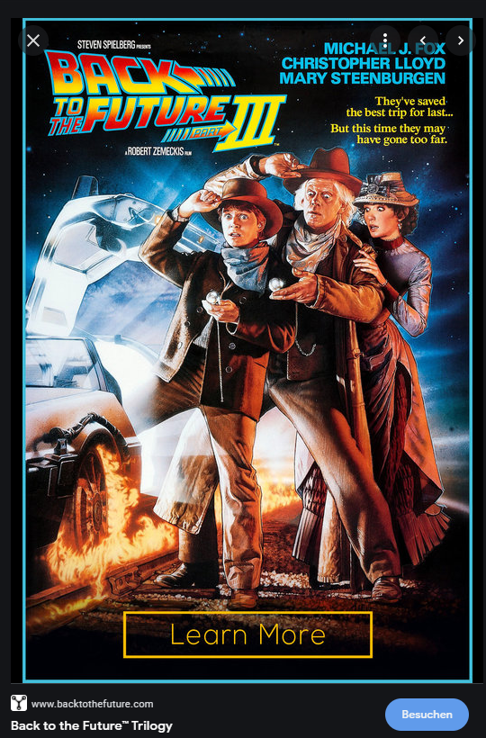
Imagining ourselves in 2029, Looking back to 2021, what is needed to ensure a post-2020 Global Biodiversity framework that galvanises all of society?
Notes:
Lets imagine we have a time machine; Humans are famously bad at short term thinking
Life is full on
Back to the Future – the stars go back and forth in time in a time machine (note gender balance and youth in picture)
Car runs on rubbish

Slide 3
Deep Time Plenary Perspectives
11.00 – 11.05: Welcome and introduction to the Session from the moderator – Jane Smart, Global Director, IUCN Biodiversity Conservation Group
11.05 – 11.13: The WCC: a pivotal moment - Bruno Oberle, IUCN Director General DG
11.13 – 11.21: Looking back at 2021 from 2029: what will we wish we had done? Carlos Manuel Rodriguez, GEF CEO
11.21 – 11.29: What happened at the Open Ended Working Group 3.1: and where are we now? Basile van Havre Co – Chair of the CBD Open Ended Working Group (Video message)
11.29 – 11.37: The role and importance of Stakeholders in achieving the Post-2020 Global Biodiversity Framework, Elizabeth Maruma Mrema, Executive Secretary of the Convention on Biological Diversity (by video-link)

Slide 4
Perspectives from stakeholders: views from “Deep Time” on engagement in the post-2020 global biodiversity framework
Marco Lambertini, DG, WWF International, co-host of the Post-2020 Pavilion Partnership, a view from civil society
Guy Debonnet, Natural Heritage Unit, UNESCO World Heritage Centre, a view from a biodiversity-related convention
Rita El Zaghloul (TBC) and Adele Fardoux, Co-Chairs, High Ambition Coalition Countries
Carla Manjate Rombe, Senior Gender Officer, IUCN ESARO, a view on behalf of women / gender considerations
Melina Sakiyama, Global Youth Biodiversity Network, a view from Youth
Jennifer (Jing) Tauli Corpuz, Global Policy and Advocacy Lead Policy Advisor, Nia Tero, a view from IPLCs
Christina Voigt, University of Oslo; Official candidate for chair of the IUCN WCEL, a view from lawyers
Tom Brooks, IUCN Chief Scientist: how we can measure stakeholder contributions over time?
Drawing out common messages from stakeholder groups through interactive Q & A and discussion
Reactions from:
David Cooper, Deputy Executive Secretary, Secretariat of the CBD
Amy Fraenkel, Executive Secretary, Convention on Conservation of Migratory Species of Wild Animals
Martha Rojas Urrego, Executive Secretary, Ramsar Convention
Transmitting conclusions into the Marseille Manifesto

Slide 5
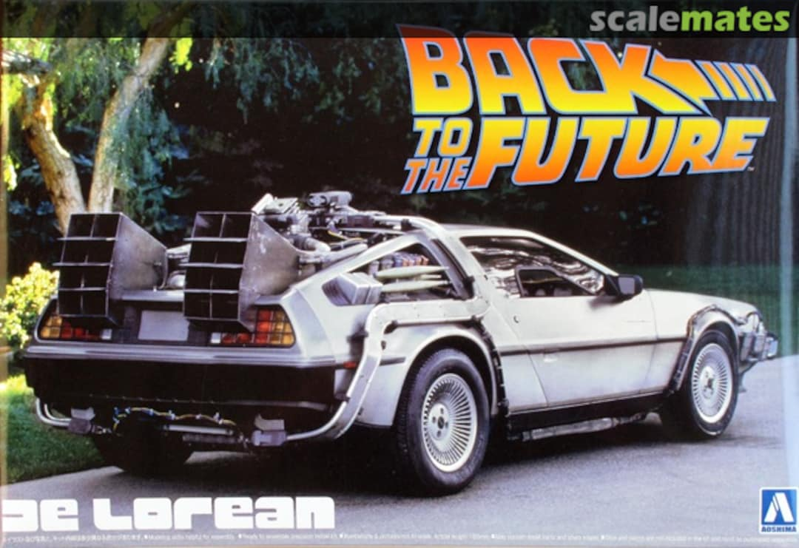
Notes:
This particular car ran on rubbish

